Slide 1
Distributed Transaction Management
Chapter 10
Introduction to Transaction Management
Notes:
1

Slide 2
What is a Transaction?
A transaction is a sequence of database operations organized in a basic unit for keeping database consistent and reliable..

Slide 3
Consistency of Database
A database is in a consistent state if it follows:
entity integrity
referential integrity
domain value constraints, etc.

Slide 4
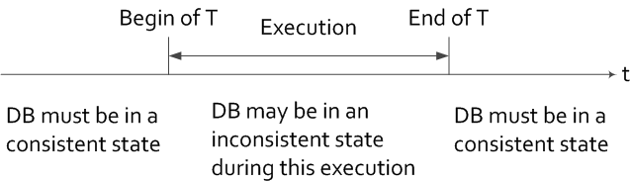
A temporary inconsistent state of a transaction
should not be exposed to other transactions.
A database should be in a consistent state even
if there are a number of concurrent transactions
accessing the database.

Slide 5
Reliability of Database
A database is reliable if it is resilient and capable of recovering.

Slide 6
Transaction
A transaction is a sequence of read and write
operations on a database with some special
properties (ACID).
An SQL statement is a transaction.
An embedded SQL statement is a transaction.
A program enclosed by “Begin-transaction” and “end” is
a transaction.

Slide 7
An Airline Database Example
FLIGHT(FNO, DATE, SRC, DEST, STSOLD, CAP)
CUST(CNAME, ADDR, BAL)
FC(FNO, DATE, CNAME, SPECIAL)

Slide 8
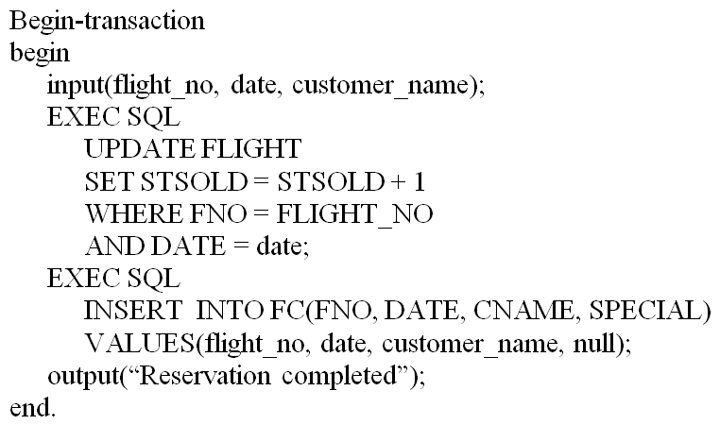
Example Transaction – SQL Version
The reservation program

Slide 9
Termination Conditions of Transactions
A transaction may be terminated by command of
  commit, i.e. successfully completed, or
  rollback, i.e. aborted
Commit makes DB operations effect permanent and the result is visible to other transactions.
Rollback undoes all DB operations and restore the DB to the state before the execution of the transaction.

Slide 10
Termination of Transaction Example
Begin_transaction Reservation
begin
input(flight_no, date, customer_name);
EXEC SQL SELECT STSOLD,CAP
INTO temp1,temp2
FROM FLIGHT
WHERE FNO = flight_no AND DATE = date;
if (temp1 == temp2) then { output(“no free seats”); Abort }
else { EXEC SQL UPDATE FLIGHT
SET STSOLD = STSOLD + 1
WHERE FNO = flight_no AND DATE = date;
EXEC SQL INSERT
INTO FC(FNO, DATE, CNAME, SPECIAL);
VALUES (flight_no, date, customer_name, null);
Commit
output(“reservation completed”)
}
endif
end {Reservation}

Slide 11
Transaction Example
T:
Read(x)
Read(y)
x ← x + y
Write(x)
Commit
R(x)
W(x)
C
R(y)
Σ = { R(x), R(y), W(x), C }
< = { (R(x), W(x)), (R(y), W(x)) , (W(x), C), (R(x), C), (R(y), C)}

Slide 12
Example Transaction – Reads & Writes
Begin_transaction Reservation
begin
input(flight_no, date, customer_name);
temp ← Read(flight(date).stsold);
if (temp == flight(date).cap) then
begin
output(``no free seats'');
Abort;
end
else begin
Write(flight(date).stsold, temp + 1);
Write(flight(date).cname, customer_name);
Write(flight(date).special, null);
Commit;
output(``reservation completed'')
end
end. {Reservation}

Slide 13
Characterization of Transactions
Read Set (RS)
  the set of data items that are read by a transaction
Write Set (WS)
  the set of data items whose values are changed by this transaction
Base Set (B)
  RS ∪ WS

Slide 14
Formalization
Let
  O_{ij}(x) be some operation O_{j} of transaction T_{i} operating on entity x, where O_{j} ∈ {read,write} and O_{j} is atomic
  OS_{i} = ∪_{j} O_{ij}
  N_{i} ∈ {abort, commit}
Transaction T_{i} is a partial order T_{i} = { Σ_{i} , <_{i} } where
  Σ_{i} = OS_{i} ∪ {N_{i} }
  For any two operations O_{ij}, O_{ik} ∈ OS_{i} , if O_{ij} = R(x) and O_{ik} = W(x) for any data item x, then either
O_{ij} <_{i} O_{ik} or O_{ik} <_{i} O_{ij}
  ∀ O_{ij} ∈ OS_{i} , O_{ij} <_{i} N_{i}

Slide 15
Conflict Operations
<_{i} is an ordering relation for database operations of T_{i} . Two operations are in conflict if one of them is a write.

Slide 16
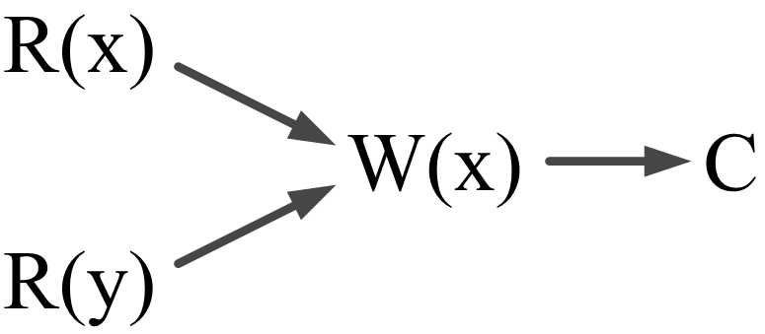
Directed Acyclic Graph
A partial order can be represented by a DAG (Directed Acyclic Graph) whose vertices are the operations and edges are ordering.

Slide 17
Directed Acyclic Graph (cont.)
No order exists between R(x) and R(y)
A transaction can be simplified by using its relative order of operations, e.g., the above
T can be written as:
T = {R(x),R(y),W(x),C}

Slide 18
Properties of Transactions -- ACID
ATOMICITY
all or nothing
CONSISTENCY
no violation of integrity constraints
ISOLATION
concurrent changes invisible and serializable
DURABILITY
committed updates persist

Slide 19
Atomicity
Either all or none of the transaction's operations are performed.
Atomicity requires that if a transaction is interrupted by a failure, its partial results must be undone.
The activity of preserving the transaction's atomicity in presence of transaction aborts due to input errors, system overloads, or deadlocks is called transaction recovery.
The activity of ensuring atomicity in the presence of system crashes is called crash recovery.

Slide 20
Consistency
Internal consistency
  A transaction which executes alone against a consistent database leaves it in a consistent state.
  Transactions do not violate database integrity constraints.
The consistency of a transaction is simply its correctness
A transaction is a correct program that maps one consistent database state to another .
The property to be guaranteed by concurrency control.

Slide 21
Consistency (cont.)
Four levels of consistency can be defined on the basis of dirty data concept.
Dirty data - data values that have been updated by a transaction prior to its commitment.
Consistency degree Conditions | 3 | 2 | 1 | 0
A transaction T does not overwrite dirty data of other transactions. |  |  |  | √
+ A transaction T does not commit any writes until it completes all writes, i.e. until the end of T. |  |  | √
+ T does not read dirty data from other transactions. |  | √
+ Other transactions do not dirty any data read by T before T completes. | √

Slide 22
Isolation
Serializability
  If several transactions are executed concurrently, the results must be the same as if they were executed serially in some order.
Incomplete results
  An incomplete transaction cannot reveal its results to other transactions before its commitment.
  Necessary to avoid cascading aborts.

Slide 23
Isolation Example
Consider the following two transactions:
Possible execution sequences:
T₁: Read(x)
x ←x+1
Write(x)
Commit
T₂: Read(x)
x ←x*10
Write(x)
Commit
T₁ : Read(x)
T₁ : x ← x+1
T₁ : Write(x)
T₁ : Commit
T₂ : Read(x)
T₂ : x ← x*10
T₂ : Write(x)
T₂ : Commit
T₁ : Read(x)
T₁ : x ← x+1
T₂ : Read(x) T₁ : Write(x)
T₂ : x ← x*10
T₂ : Write(x)
T₁ : Commit T₂ : Commit

Slide 24
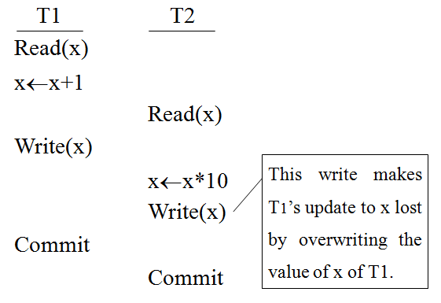
Reasons for Requiring Isolation
Lost update

Slide 25
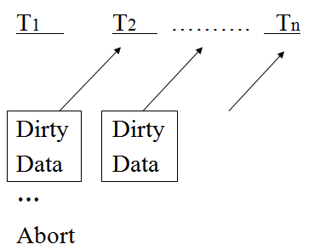
Reasons for Requiring Isolation (cont.)
Cascading abort
T_{i} reveals its data to T_{i+1} before commit, when T₁ aborts, all other transactions must abort.

Slide 26
SQL­92 Isolation Levels
Phenomena that can occur if proper isolation is not maintained
1) Dirty read
T₁ modifies x which is then read by T₂ before T₁ terminates; T₁ aborts ⇒ T₂ has read value which never exists in the database.
2) Non­ repeatable (fuzzy) read
T₁ reads x; T₂ then modifies or deletes x and commits. T₁ tries to read x again but reads a different value or can't find it.
3) Phantom
T₁ searches the database according to a predicate while T₂ inserts new tuples that satisfy the predicate.

Slide 27
SQL­92 Isolation Levels (cont.)
Isolation levels
  Read Uncommitted
    For transactions operating at this level, all three phenomena are possible.
  Read Committed
    Fuzzy reads and phantoms are possible, but dirty reads are not.
  Repeatable Read
    Only phantoms possible.
  Anomaly Serializable
    None of the phenomena are possible.

Slide 28
Consistency Degree vs. Isolation
Consistency degree level 3 provides complete isolation.
Consistency degree level 2 avoids cascading aborts
Consistency degree level 0 avoids lost update
Consistency degree Conditions | 3 | 2 | 1 | 0
A transaction T does not overwrite dirty data of other transactions. |  |  |  | √
+ A transaction T does not commit any writes until it completes all writes, i.e. until the end of T. |  |  | √
+ T does not read dirty data from other transactions. |  | √
+ Other transactions do not dirty any data read by T before T completes. | √

Slide 29
Durability
Once a transaction commits, the system must guarantee that the results of its operations will never be lost in spite of subsequent failures.
Durability demands recovery functions of a DBMS.

Slide 30
Types of Transactions
Based on
  Application areas
    Non-distributed vs. Distributed
    Compensating transactions, if the purpose is to undo the effect of previous transactions
    Heterogeneous transactions, if running in a heterogeneous DBMS
  Timing
    On-line (short-life) vs. batch (long-life)

Slide 31
Types of Transactions (cont.)
  Organization of read and write actions
    Two-step (e.g., all read actions before any write)
    Restricted (e.g., for a data item, read-before-write)
    Action model (e.g., restricted, each <read, write> pair executed atomically)
    Write prior read
  structure
    Flat (or simple) transactions
    Nested transactions
    Workflows

Slide 32
Transaction Structure - Flat
Flat transaction consists of a sequence of primitive operations embraced between a begin and end markers.
Begin_transaction Reservation
...
end.

Slide 33
Transaction Structure - Nested
The operations of a nested transaction may themselves be transactions.
Begin_transaction Reservation
...
Begin_transaction Airline
-- ...
end. {Airline}
Begin_transaction Hotel
...
end. {Hotel}
end. {Reservation}

Slide 34
Nested Transactions
Have the same properties as their parents → may themselves have other nested transactions.
Introduce concurrency control and recovery concepts to within the transaction.
Types
  Closed nesting
    Sub-transactions begin after their parents and finish before them.
    Commitment of a sub-transaction is conditional upon the commitment of the parent (commitment through the root).
  Open nesting
    Sub-transactions can execute and commit independently.
    Compensation may be necessary.

Slide 35
Workflows
“A collection of tasks organized to accomplish some business process.”
Types
  Human-oriented workflows
    Involve humans in performing the tasks
    System support for collaboration and coordination; but no system-wide consistency definition
  System-oriented workflows
    Computation-intensive & specialized tasks that can be executed by a computer
    System support for concurrency control and recovery, automatic task execution, notification, etc.

Slide 36
Workflows (cont.)
  Transactional workflows
    In between the previous two; may involve humans, require access to heterogeneous, autonomous and/or distributed systems, and support selective use of ACID properties

Slide 37
Workflow Example
T3
T1
T2
T5
T4
Customer
Database
Customer
Database
Customer
Database
T1: Customer request obtained
T2: Airline reservation performed
T3: Hotel reservation performed
T4: Auto reservation performed
T5: Bill generated

Slide 38
Transactions Provide ...
Atomic and reliable execution in the presence of failures
Correct execution in the presence of multiple user accesses
Correct management of replicas (if they support it)

Slide 39
Transaction Processing Issues
Transaction structure (usually called transaction model)
  Flat (simple), nested
Internal database consistency
  Semantic data control (integrity enforcement) algorithms
Reliability protocols
  Atomicity & Durability
  Local recovery protocols
  Global commit protocols

Slide 40
Transaction Processing Issues (cont.)
Concurrency control algorithms
  How to synchronize concurrent transaction executions (correctness criterion)?
  Intra­-transaction consistency, Isolation
Replica control protocols
  How to control the mutual consistency of replicated data?
  One copy equivalence and ROWA (Read One Write All)

Slide 41
Architecture Revisited
Begin_transaction,
Read, Write,
Commit, Abort
TM: coordinating the execution
of database operations on
behalf of an application
Results
Distributed
Execution Monitor
Transaction Manager
(TM)
Scheduling/ Descheduling
Requests
other Schedulers
Scheduler
(SC)
other Transaction
Managers
SC: implementing a specific
concurrency control to
synchronize accesses to
the database
To data
processor

Slide 42
Question & Answer

